Slide 1
Ruby on Rails
Introduction

Slide 2
Overview
Web development Framework Built on Ruby Language
Ruby created in 1993, released to general public in 1995.
Foundation for Ruby on Rails was created in 2004

Slide 3
Benefits
Rapid development of applications using concept known as convention over configuration
New applications are created by running the application generator
Generator is responsible for creating standard directory structure and files that act as the base for every Ruby on Rails application.
Less time spend how application is going to laid out.

Slide 4
Benefits (Continued)
Standard structure means there is a familiarity between applications.
Core GEMs allow you worry less on trivial tasks such as how to connect to a database.
Built in way to run tests on code.
Wealth of other Gems out there to help with most taks, you just have to find it!

Slide 5
Terms
Model View Controller:
Model: contains domain logic of application. How records in database are retrieved, validated / manipulated.
Controllers: Interact with Models to gather info to send to the View. Call methods on model classes, which may return objects that represent rows in DB. Controller can then make these objects available to the View through instance variables. Controllers also used for permission checking.
Views: Display the information gathered by the controller by referencing instance variables.

Slide 6
Terms
Assets, helpers and Mailer Directories:
Assests: Is a directory for static assets of the application, such as JavaScript, Images, CSS etc..
Helpers: Is a directory for putting Ruby code that provide helper methods for just the views.
Mailers: Is a directory for classes of the application that deal with sending email.

Slide 7
Terms
REST:
MVC in Rails is aided by Representation State Transfer (REST).
REST is the convention for routing in Rails.
Routing refers to how requests are routed within the application itself.

Slide 8
Getting Started
To Generate a new Application we use the new command:
$rails new hello_app
Note like most languages, there are reserved words that wont work, for example:
$rails new rails
Invalid application name rails, constant Rails is already in use. Please choose another application name.

Slide 9
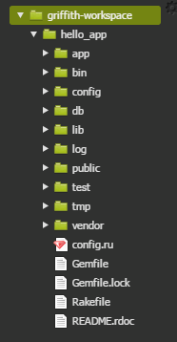
Getting Started (Continued)
After creating your App, a folder of that name will be created. Move into that folder to begin.
To start the application running, type: $rails server

Slide 10
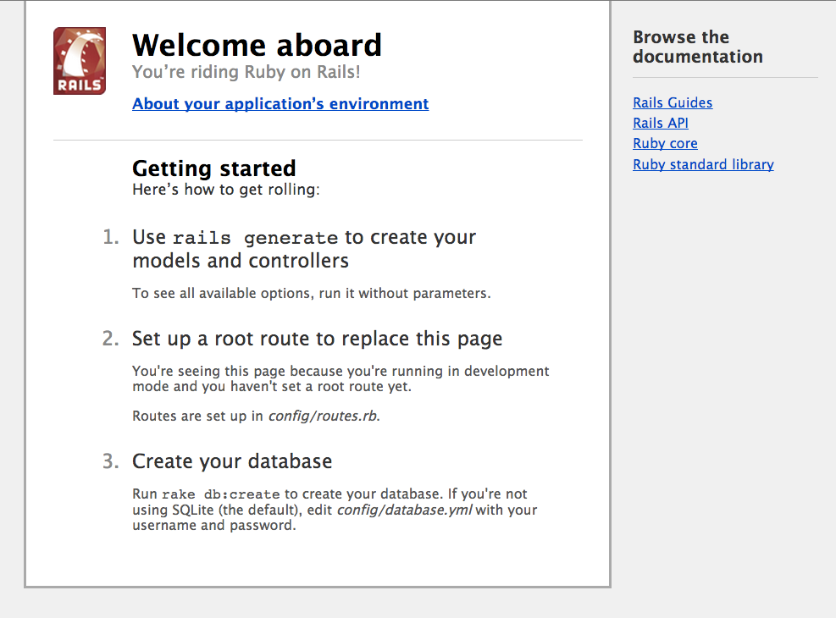
Getting Started (Continued)

Slide 11

Scaffolding
Scaffolds in Rails provide a lot of basic functionality and are generally used as a temporary structure to get started.
We use the generate argument to the rails command followed by what it is to generate, i.e scaffold.
Scaffold generates:
Models
Controller
Views
Tests

Slide 12
Scaffolding
Everything after the name for the scaffold are the fields for the database table and the attributes for the objects of this scaffold.
The above examples states:
The table for your purchase scaffold will contain a name and cost field, which are a string and a float, respectively.
To create this table, the scaffold generator generates what’s known as a migration

Slide 13
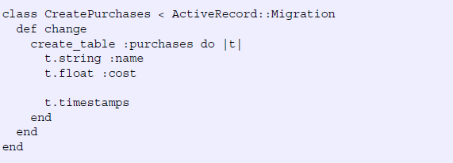

Migrations
Migrations are form of version control for DBs.
Provides way to implement incremental changes to the schema of a DB.
Each migration is Time Stamped to the second.
To run migration, we type he following command:
Notes:
Each migration is timestamped right down to the second, which provides you (and anybody else developing the application with you) an accurate timeline of your database. When two developers are working on separate features of an application and both generate a new migration, this timestamp will stop them from clashing. Let’s open the only file in db/migrate now and see what it does. Its contents are shown in the following listing.
Migrations are Ruby classes that inherit from ActiveRecord::Migration. Inside the class, one method is defined: the change method.
Inside the change method, you use database-agnostic commands to create a table. When this migration is run forward, it will create a table called "purchases", with a "name" column that's a string, a "cost" column that's a float , and two timestamp fields.

